Slide 1
Java Basic 5
Operators

Slide 2
An operator in java is a symbol or keyword that tells the compiler to perform a specific mathematical or logical operations.
They are used in programs to manipulate data and variables. They generally form mathematical or logical expressions. An expression is a combination of variables, constants, and operators.
For example, an expression is x+5. Here, the operand x is a variable, operand 5 is a constant, and + is an operator that acts on these two operands and produces the desired result.
Example: A+b
A is a operand, + is a operator, B is a operand =Operation

Slide 3
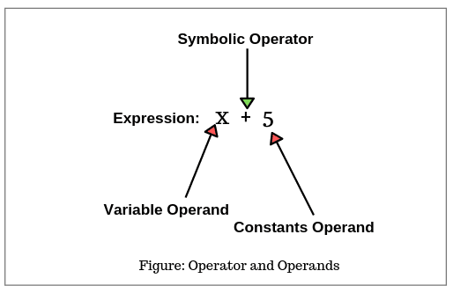
Addition operation example

Slide 4
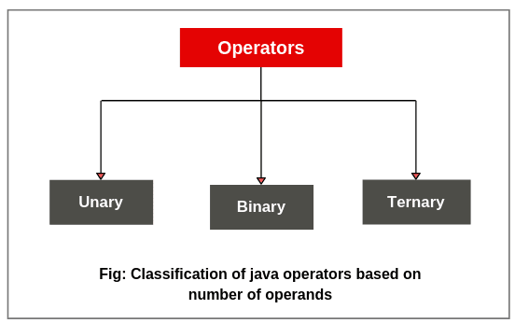
Types of operators
There are three types of operators in java based on the number of operands used to perform an operation.

Slide 5
Unary -The operator that acts on a single operand is called unary operator. A unary operator uses a single variable.
Binary -The operator that acts on two operands is called binary operator. A binary operator uses two variables.
Ternary - The operator that acts on three operands is called ternary operator. A ternary operator uses three variables.
*Based on the notation used, Java operator has been divided into two categories: Symbolic and named.

Slide 6
If a symbol like +, -, *, etc is used as an operator, it is called symbolic operator.
If a keyword(instanceof) is used as an operator, it is called named operator.

Slide 7
1. Symbolic operator in Java
Arithmetic operators: +, -, *, /, %.
Relational operators: <, >, <=, >=, = =, !=.
Logical operators: &&, ||, !.
Assignment operators: =,
Increment and decrement operators: + +, – –
Conditional operators: ?:
Bitwise operators: &, !, ^, ~, <<, >>, >>>
Shift operators: <<, >>, >>>.
2. Named operators in Java
instanceof operator

Slide 8
Bitwise operator
a | b | a&b
0 | 0 | 0
1 | 0 | 0
0 | 1 | 0
1 | 1 | 1
a | b | a|b
0 | 0 | 0
1 | 0 | 1
0 | 1 | 1
1 | 1 | 1
a | b | A^b
0 | 0 | 0
1 | 0 | 1
0 | 1 | 1
1 | 1 | 0
a | ~b
0 | 1
1 | 0

Slide 9
Operator precedence
Arithmetic operators
1. High priority: * / % 2. Low priority: + –
If parentheses are used in the expression, the expression with parentheses will be assumed with the highest priority.
If two or more sets of parentheses occur into the expression one after another, the order of evaluation will be done from left set towards the right set.

